Slide 1
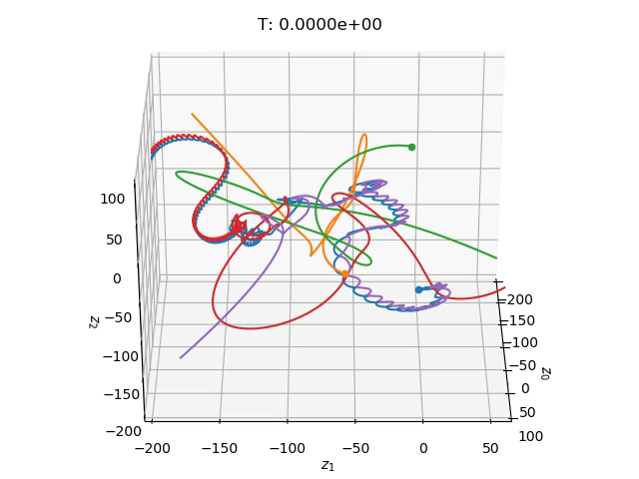
An Adaptive Symplectic Integrator to Model the Mechanics of Self-Gravitating Systems Nishant Mishra¹, Ammar Hakim² PPPL High School Summer Internship 2020
¹Princeton High School, ²Princeton Plasma Physics Laboratory (PPPL)

Slide 2
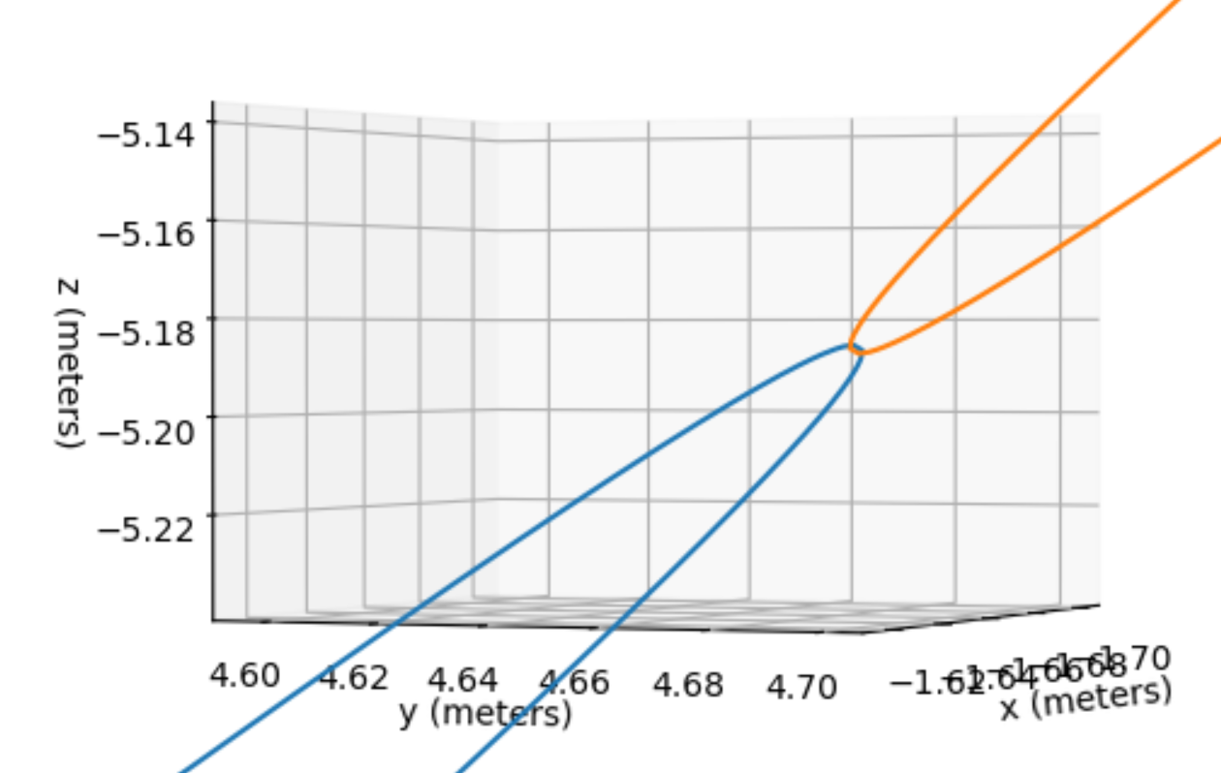
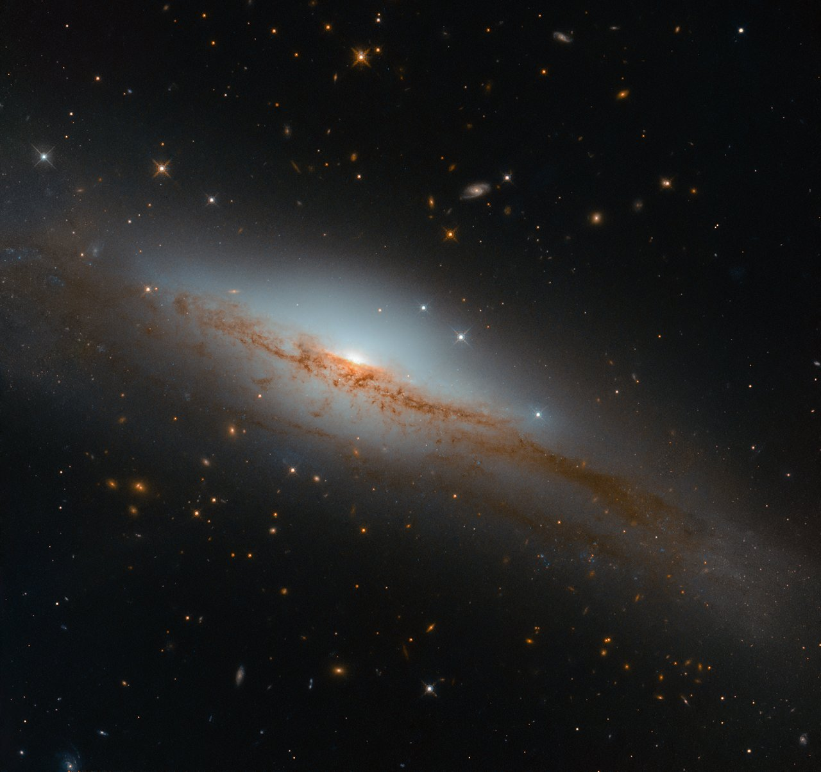
Introduction
[1]
Two Particles
Billions of Particles
The middle-range (10s, 100s, 1000s)
[1]: ESA/Hubble & NASA, D. Rosario et al.

Slide 3
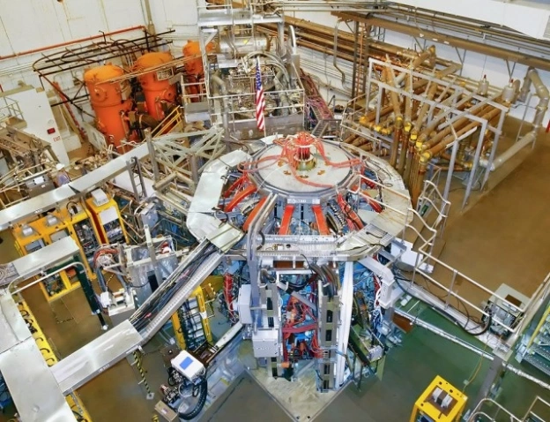
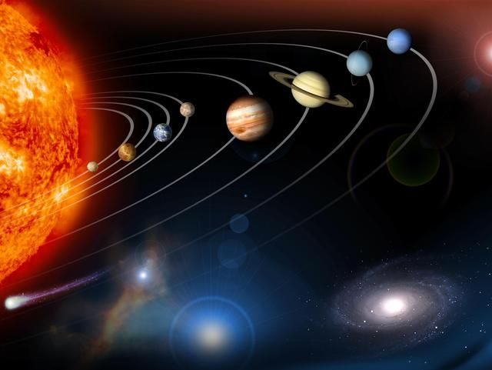
Why Understand/Model These Systems?
Here at PPPL: Keeping fast, hot ions within range for fusion in tokamaks like NSTX-U
Interesting Questions
Stability of our Solar System
Possibility of “Planet 9” being a planet-mass black hole
[2]
[3]
[2]: Outside view of the NSTX reactor [Digital image]. (n.d.). Retrieved from https://en.wikipedia.org/wiki/National_Spherical_Torus_Experiment#/media/File:NSTX.jpg
[3]: [Digital image]. (2019, November 22). Retrieved August 08, 2020, from https://www.nasa.gov/ames/press-release/nasa-selects-new-research-teams-to-further-solar-system-exploration-research

Slide 4
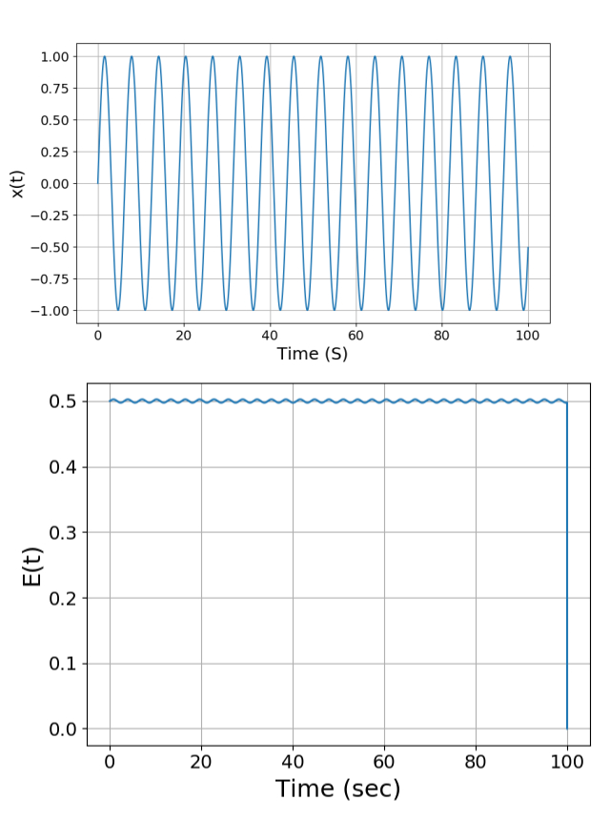
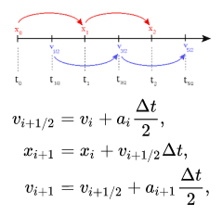
Feasibility Test – Simple Harmonic Oscillator
Begun with modeling the motion and energy of the simple harmonic oscillator
Modeled under a second-order leapfrog scheme
Computed and plotted in Python
Accurate “Location Plot”
Having no outside forces should yield a constant total energy plot, but it’s sinusoidal instead- characteristic of all leapfrog integrators.
SHM Location/Energy Plots

Slide 5
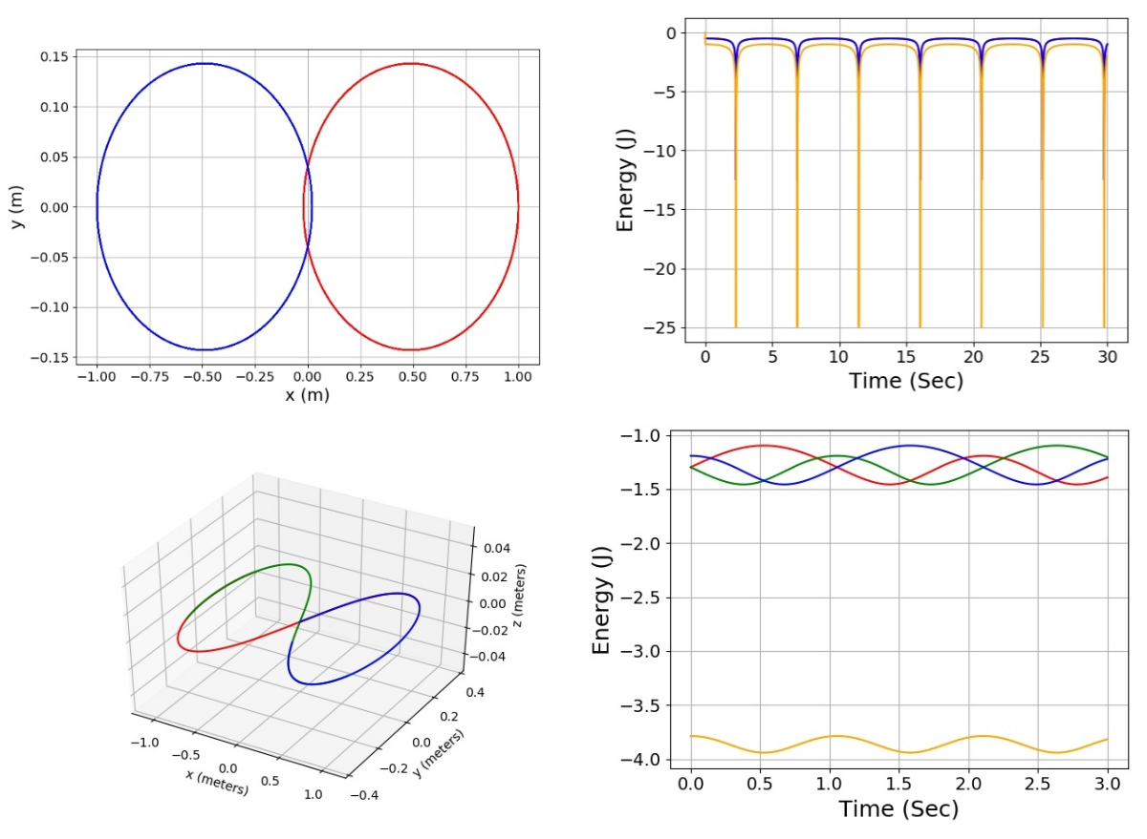
The Two/Three Body Problem
Plots of the two and three body problem under the leapfrog scheme with given test parameters
Computed with C, plotted with Python
Computation was done between each pair of particles in the system
Integrator Weaknesses:
Fixed time step (dt) makes it possible to miss finer levels of physical interaction when particles are near each other
“Total Energy” plot is sinusoidal instead of constant
Limited to two/three bodies
2- And 3- Body Location Plots
2- And 3-Body Energy Plots
Location Plots Key
Each curve (Red, Green, Blue) represents the path/behavior of a different particle.
Energy Plots Key
Red, Green Blue – Total Particle Energies
Yellow – System Total Energy

Slide 6
Adaptive Time-Stepping Algorithmic Structure
To fix the possibility of missing physical interaction with a time step that is too large, we decided to add an adaptive time-stepping algorithm to the original C code. The new algorithm computes three values each loop – the locations of the particle with the original time step, a doubled time step, and a halved time step.
If the distance between the locations of the halved time step and the original is too large -> the halved time step becomes the new default
Improves the accuracy of the integrator during close particle interactions
If the distance between the locations of the doubled time step and the original is too small -> the doubled time step becomes the new default
Helps speed up the computation time of the algorithm

Slide 7
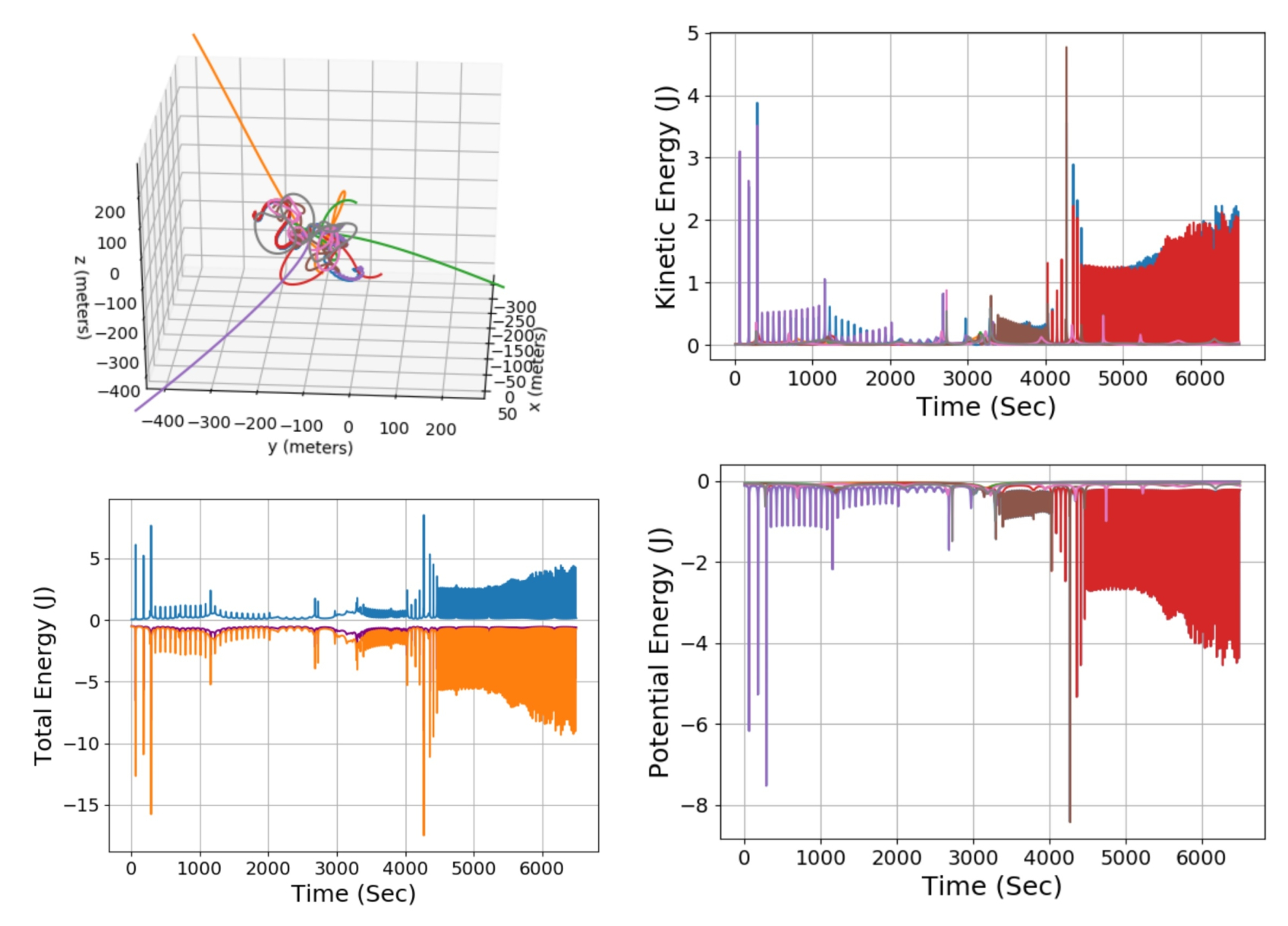
Jumping to N-Bodies/8 Body Test Case
Next, the leapfrog integrator code was generalized to plot any number of bodies for a set time interval
Tested with eight bodies distributed randomly within a 100-meter sphere and given a random velocity between -0.1 m/s to 0.1 m/s
Test Notes:
Couple of binary sub-systems and three particle ejections
“Combined Energy” plot (purple) is fairly level
8-Body Location Plot
8-Body Kinetic/Potential Energy Plots
Total Energy Key
Orange/Green – Total Kinetic/Potential Energy
Blue - Combined Energy (Potential + Kinetic)
Location, KE, PE Key
Each curve represents the path/behavior of a different particle, with the eight different colors corresponding across the three plots

Slide 8
Final Animation – Integrator Strengths and Weaknesses
Animated to model five of the particles in the eight-body system (~6.5k seconds, ~330k data points)
Blue/Purple particle binary gets separated by close interactions (~3.1k sec) and eventually yields a Blue/Red particle binary
Absence of pseudo-force commonly found in other integrators allows for the modeling of these binary captures/transfers
Animated 8-Body Location Plot (5 Particles)

Slide 9
Conclusion and Future Directions
Conclusion
A user-friendly, adaptive leapfrog integrator that can be used to simulate a wide range of self-gravitating systems consisting of a large number of particles – useful for studying the statistical mechanics of gravitational/electromagnetic systems.
Future Directions
Swap out the Leapfrog scheme with other schemes (ex. Runge-Kutta) and compare the difference in location and energy plot
Determine the stability or stochasticity of systems in question – take each particle and add trace “ghost” particles that move under the influence of forces already existing in the system with slightly perturbed initial velocities.

Slide 10
Acknowledgements
Special thanks to Dr. Ammar Hakim, my research mentor, for all of the guidance he gave me for the duration of my project, as well as to Shannon Greco, who advised me on the logistics of the program.
This work was made possible by funding from the Department of Energy for the PPPL High School Summer Internship program.
Thank you!

